Slide 1


Home Credit Group Loan Defaulter Prediction
Md Saimoom Ferdous, PhD
Springboard Data Science Career Track, March 2020 Cohort
Mentored by
Rahul Sagrolikar
Senior Data Scientist, Amazon

Slide 2
Table of Contents
Problem Statement
Project Flow, Business & Model Understanding
Data Collection
Loan application data
Exploratory Data Analysis
Correlated Variables
Machine Learning Modelling
TensorFlow
Random Forest
GBM
XGBoost
Voting Classifier
Conclusion

Slide 3

Section 1:
Problem Statement

Slide 4
Project Flow
Problem
Solution
With little information hard to decide on loan sanction
Know the important features to look at
Business
Imbalance data set weighs in for majority class
Important features extraction from the trained models
Loan defaulter prediction

Slide 5
Project Flow - Details
Problem
Solution
Home Credit Group – needs to disburse loans to most vulnerable group with little to no information
Need to make balance, real defaulters don’t get loans (FN) and non-defaulters are not barred from loans (FP)
Knowing the most important features to look at
Minimize FN/FP ratio
Business
Minority class always has very less population than majory class which leads to bias
Trained model can have better separability yet having high FN/FP ratio
Under-sampling is better option for making balanced dataset
Model training and Explainability can help identify and quantify important features
Loan defaulter prediction

Slide 6
Section 2:
Data Collection and Wrangling GitHub Link

Slide 7
Data
Kaggle data Sourced from Home Credit Group Inc.
Application
Contains 307.5 K clients information with 121 features and a target variable
We will limit to this file only
6 Other Files
Contains information about ‘bureau’, ‘previous credit/cash balance’, ‘installments’ information
Data Wrangling
Missing values fixed and duplicate checked
Saved cleaned data for EDA stage
Notes:
https://visualpharm.com/

Slide 8
Section 3:
Exploratory
Data Analysis GitHub Link

Slide 9
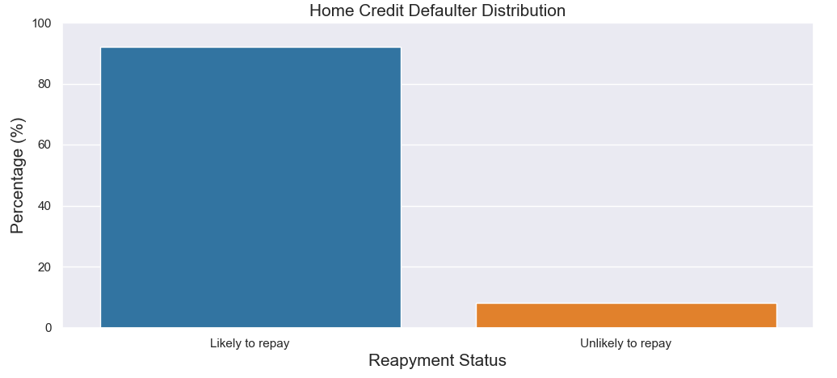
How Unbalnced the Target is?
92 % will pay the loan vs 8 % unlikely to repay
The data is highly imbalanced

Slide 10
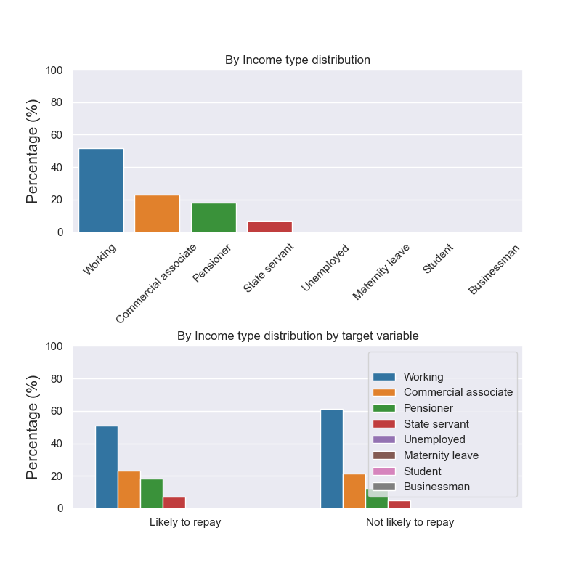
What Income Group the Clients Come from?

Slide 11
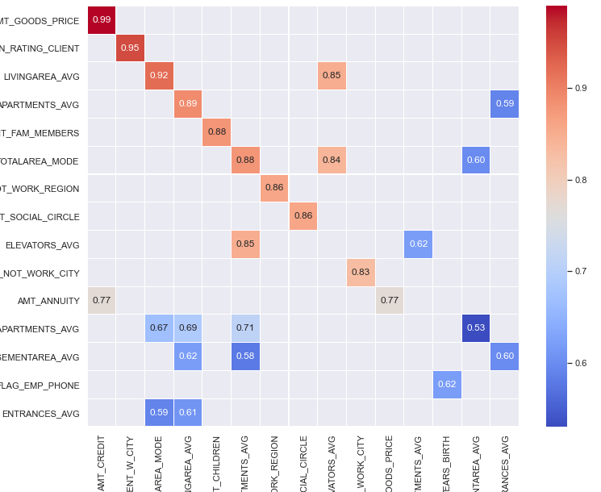
Highly Correlated Feature Removal
Variables |  | Correlations
GOODS_PRICE | CREDIT | 0.99
REGION_RATING | REGION_RATING_CLIENT | 0.95
LIVINGAREA_AVG | LIVING_AREA_MODE | 0.92
Highly correlated variables (>0.80) were dropped to avoid data redundancy

Slide 12
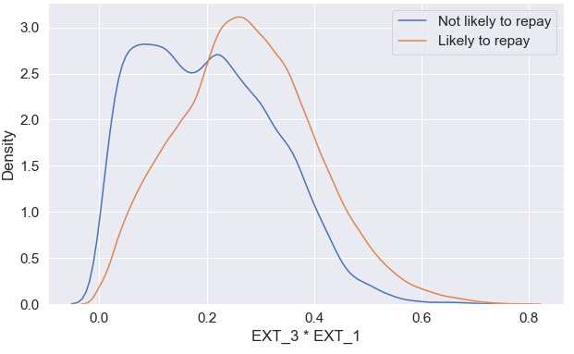
Feature Creation
14 additional features were created from anomalous features, observations and multiplicative terms
EXT_ features showed maximum correlation with ‘target’
Distribution of (EXT_3 * EXT_1) are quite distinct for ‘loan repayment’ vs ‘unlikely to repay’

Slide 13
Section 4:
Machine Learning Modelling

Slide 14
Machine Learning
Random Forest
GBM
Deep Neural Network (TensorFLow 2.0)
The scientific study of algorithms and statistical models to effectively predict future outcomes based on previously known patterns
XGBoost
Voting Classifier

Slide 15
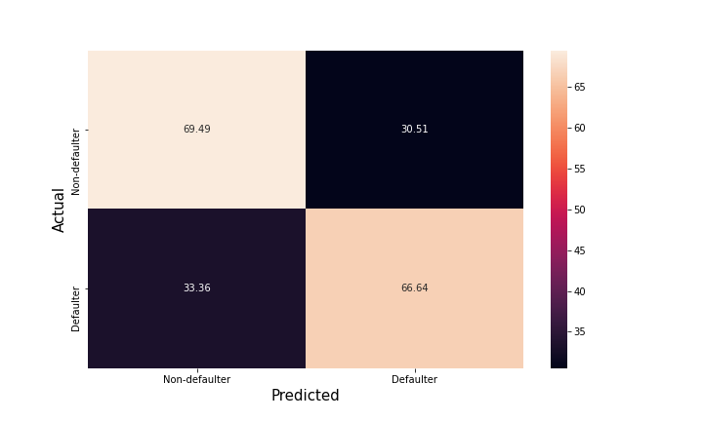
Deep Neural Network (TensorFlow 2.0)
Hyperparameter optimized
False Negative/False Positive = 33/30 %
AUC = 0.7393
Accuracy = 67.85%

Slide 16
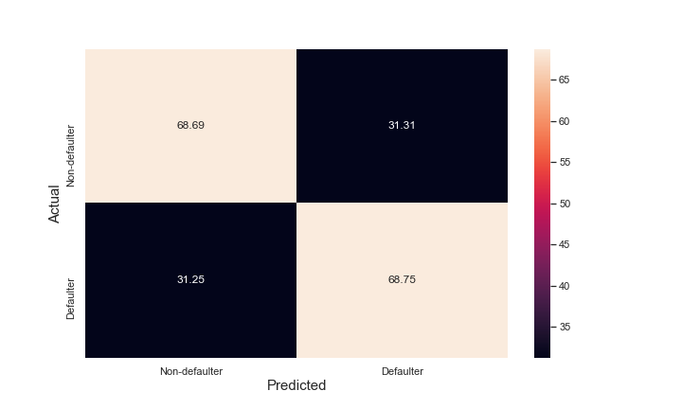
GBM
Hyperparameter optimized:
False Negative/False Positive = 31/31 %
AUC = 0.7541
Accuracy = 68.72%
Important Features:
EXT_3_2, EXT_3_1, EXT_2_1

Slide 17
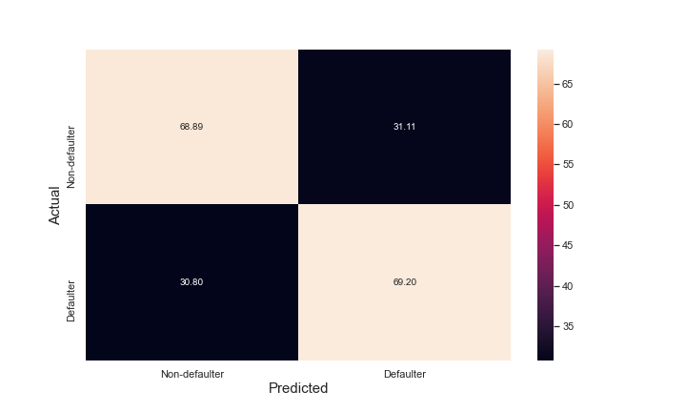
Voting Classifier
Hyperparameter optimized:
False Negative/False Positive = 31/31 %
AUC = 0.7535
Accuracy = 69.04%

Slide 18
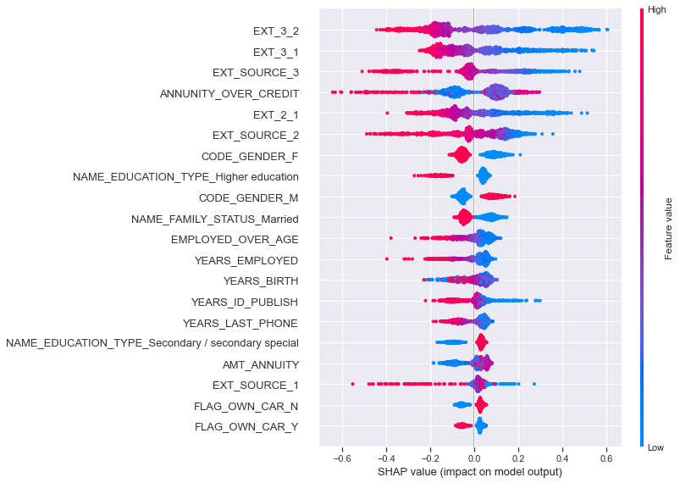
Model Explainability: SHAP Value with GBM Model
Top features with positive/negative correlativity with target variable
The magnitude of individual observation’s contribution is also shown

Slide 19
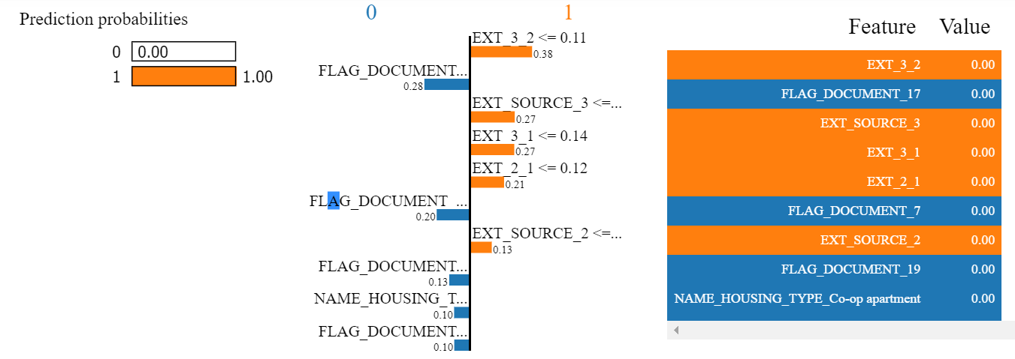
Model Explainability: LIME Coefficients with GBM Model
Lower value of EXT_3_2 positively correlates with target variable
Lower value of FLAG_DOCUMENT_17 negatively impacts target variable
Similar explanation applies to other variables

Slide 20
Machine Learning Results
Top 3 Important Features from the Models
Models | Negative Correlation | Positive Correlation
Random Forest | EXT_3_2, EXT_3_1, EXT_2_1 | -
GBM | EXT_3_2, EXT_3_1, EXT_SOURCE_3 | -
XGBoost | EXT_3_2, ANNUINITY_OVER_CREDIT, | ANNUINITY_OVER_CREDIT, CODE_GENDER_M
Metric
Model | AUC
TensorFLow 2.0 | 0.7393
Random Forest | 0.7450
GBM | 0.7541
XGBoost | 0.7537
NOTE:
GBM model got the best AUC score
Low values of EXT_3_2, EXT_3_1 scores in the male population are important to scrutiy for loan approval
GitHub Link for loan defaulter classification
Notes:
Linear Regression - MPM
t2_sat_area(microns2) = 2.514793e-04
int_s_avg_5(counts/ms) = 1.243470e-04
Random Forest - MPM
Tree = 3
t2_sat_num(-) = 0.64
int_s_p(counts/ms) = 0.33

Slide 21
Section 5:
Conclusion

Slide 22
Conclusion
EDA
Modelling
Results
Age, gender, demography, socio-economic distribution for loan repayment vs defaulter has been shown
Hyperparameter optimized for Deep Neural net, Random Forest, GBM, XGBoost and Voting Classifier models
GBM yielded best AUC score of 0.7541 which is 2.6% improvement over base model
Low threshold of EXT_3_2, EXT_3_1, EXT_2_1 in the male clients are prone to becoming loan defaulters
Unknown variables (EXT_X, X=3, 2, 1) are highly correlated with ‘target’ variable
Feature importance and explainability was determined for tree based models

Slide 23
Looking Forward
Data Balancing Method
Feature Engineering
Optimization
Online App Deployment
Currently not done | Manual feature engineering | Step by step hyperparameter optimization for TF model | Currently not done
Over sampling and synthetic data creation | Automatic feature engineering with additional dataset | Keras tuner can be used | This model can be integrated into production step
Current
Future

Slide 24
Thank You
Md Saimoom Ferdous
Email: saimoom_026@yahoo.com
LinkedIn: https://www.linkedin.com/in/saimoom-ferdous/
GitHub: https://github.com/saimoom026
Project Details: https://github.com/saimoom026/Springboard/tree/student-branch/springboard/Capstone%20Three

